Slide 1
Introducing Spring XD
Dr. Mark Pollack, Pivotal

Slide 2

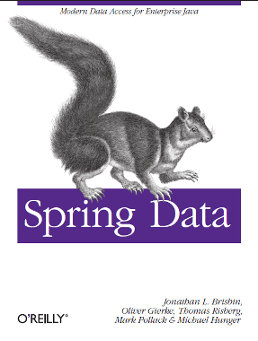
Where I’m coming from…
Big Physics -> Big Data
‘90s @ BNL/FNAL/CERN/INFN
Finance
TIBCO, Reuters, CodeStreet
OpenSource
SpringSource -> VMware -> Pivotal
Spring Framework & .NET – 2004
Spring Data – 2010
Co-author O’Reilly Spring Data Book
Spring XD – 2012

Slide 3
Agenda
Spring Overview
Spring XD

Slide 4
Some things stay the same…
“I believe that Spring is unique, for several reasons:
It addresses important areas that many other popular frameworks don‘t
Spring is both comprehensive and modular.
Spring is designed from the ground up to help you write code that's easy to test.
Spring is an increasingly important integration technology”
- Rod Johnson, TheServerSide.com, 2005

Slide 5

















Spring IO Platform
XD
BOOT
GRAILS
Stream, Taps, Jobs
Bootable, Minimal, Ops-Ready
Full-stack, Web
INTEGRATION
BATCH
BIG DATA
WEB
Big,
Fast,
Flexible
Data
Channels, Adapters, Filters, Transformers
Jobs, Steps, Readers, Writers
Ingestion, Export, Orchestration, Hadoop
Controllers, REST, WebSocket
DATA
Web,
Integration,
Batch
RELATIONAL
NON-RELATIONAL
CORE
FRAMEWORK
SECURITY
GROOVY
REACTOR

Slide 6














Spring Data
Data Technologies
Programming Model
JPA/JDBC
Consistency
Accuracy
JPA != NoSQL
Productivity
Template classes
Object Mapping
Repositories
QueryDSL
Gemfire
6

Slide 7
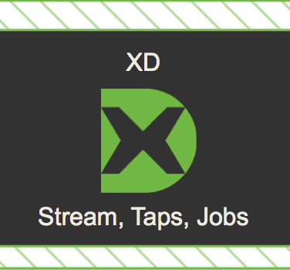
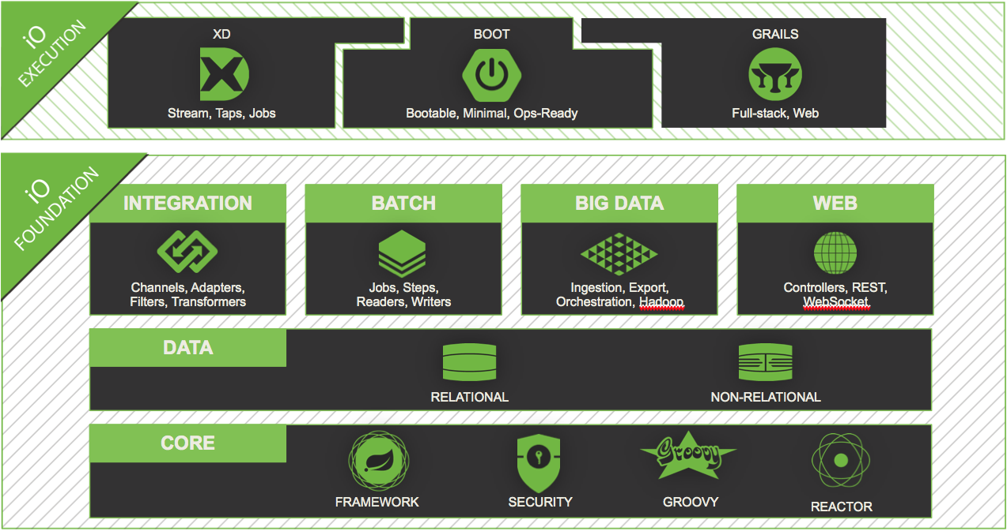
SPRING IO EXECUTION:
Spring XD

Slide 8
What is a Big Data application?
Not just writing a few MR or Hive/Pig jobs.
Developing a comprehensive solution can be challenging
Key parts of the lifecycle involve
Ingestion
Stream Processing
Batch Workflow Orchestration
Export
Also requires
Enterprise Integration
Horizontally scalable deployments
How do you write one of these apps?
Status quo is to combine different projects together – not ideal
Notes:
Ingestion: Multiple sources to HDFS, Splunk
Stream Processing: Transformation, Analytics, In-memory data grids
Workflow orchestration: Hadoop jobs, traditional batch jobs.
, keeping in mind need for data-node affinity.
- be very explicit that Big Data App = Streams PLUS Hadoop Jobs & Batch PLUS Integration (keep it simple)
- say that we think maybe nobody has done this mix yet, and it is exciting
- get Dararith to help you with some pictures
- have more pictures sooner
- lots of real world examples please

Slide 9
Introducing Spring XD
Goal: One stop shop for writing Big Data applications
XD = eXtreme Data
Provides a scalable distributed runtime for
Stream processing
Batch processing
Communication between the two processing domains
“Simple things should be simple, complex things should be possible”
http | transform | hdfs
hdfsjdbc --resources=/data/*.csv
--names=forename,surname,address --tableName=people
Open Source
Builds on mature Spring libraries
Spring Integration, Batch (JSR-352), Data

Slide 10
Spring XD Features
Unified Platform
Streams and Batch
Architecture
Scalable
Distributed
Pluggable middleware
Fault Tolerant (M6)
Developer Productivity
Interactive Shell
DSL for stream and jobs definitions
Many pre-built components – 0 code
Sinks, sources, jobs, analytics
UI for Batch Workflow Management
Modular Extensibility
Classpath isolation of components
Spring component model
Boot based contribution model (M7)
Programming Model
POJO, JSON, Tuple
Test friendly
Portable Runtime
Standalone
Amazon EC2
Hadoop YARN (M6)
CloudFoundy (WIP)
Hadoop Distribution Agnostic

Slide 11


Spring XD – 10,000 foot view
Files
Sensors
Mobile
Social
Spring XD Shell
Spring XD Runtime
Streams
Jobs
Ingest
Workflow
MR, Hive, Pig,
Cascading, SQL
Taps
Export
Redis
RDBMS
Compute
Gemfire
Export
HDFS
NoSQL
R, SAS
Predictive modeling

Slide 12
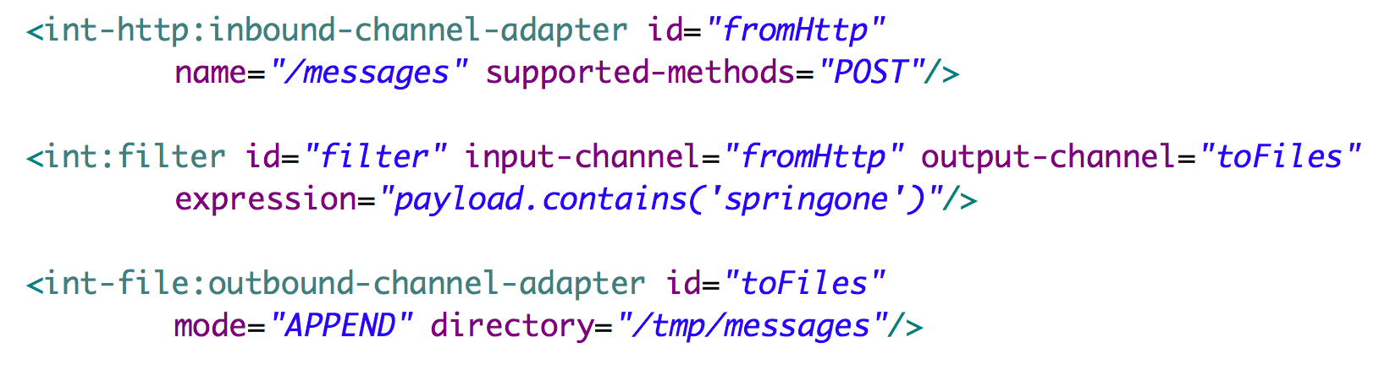
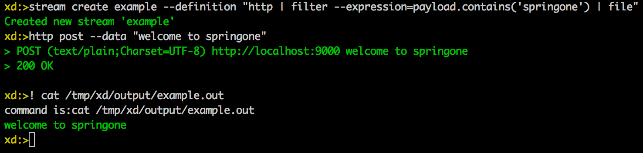
Spring XD – Streams
http | filter | file
How can we make this easier?
Non-linear stream definitions also supported

Slide 13
Spring XD – Streams
MessageStore
HTTP
Tail
File
Mail
Twitter
Gemfire
Syslog
Tcp
JMS
RabbitMQ
MQTT
Filter
Transformer
Aggregator
Groovy Script
Counters
Java Code
File
HDFS
JDBC
TCP
Mail
RabbitMQ
Gemfire
Splunk
MQTT
Dynamic Router

Slide 14



Spring XD Demo
Streams
Notes:
http | file
http | hdfs
twittersearch | hdfs
aggregatecounter on hashtags

Slide 15
Spring XD – Runtime
XD Shell
HTTP POST /streams/myStream “http | file”
XD Admin
Assigns Modules to Containers
Control Transport
Spring App Context
XD Container
XD Container
HTTP
Module
File
Module
Data Transport

Slide 16
Spring XD – Runtime
XD Shell
HTTP POST /streams/aStream “M1 | M2”
XD Admin
Assigns Modules to Containers
Control Transport
Spring App Context
XD Container
XD Container
HTTP
Module
M1
File
Module
M2
Data Transport

Slide 17
Spring XD Demo
Streams
- Distributed
Notes:
http | file
http | hdfs
twittersearch | hdfs
aggregatecounter on hashtags

Slide 18
Spring XD – Runtime – Fault Tolerance (M6)
XD Shell
HTTP POST /streams/aStream “M1 | M2”
XD Admin
XD Admin
(leader)
XD Admin
Container State
Control Transport
ZooKeeper
Spring App Context
XD Container
XD Container
HTTP
Module
M1
File
Module
M2
Data Transport

Slide 19
Spring XD – Runtime – Fault Tolerance
XD Shell
HTTP POST /streams/aStream “M1 | M2”
XD Admin
XD Admin
(leader)
XD Admin
Container State
Control Transport
ZooKeeper
XD Container
File
Module
M2
Data Transport

Slide 20
Spring XD – Runtime – Fault Tolerance
XD Shell
HTTP POST /streams/aStream “M1 | M2”
XD Admin
XD Admin
(leader)
XD Admin
Container State
Control Transport
ZooKeeper
XD Container
File
Module
M2
HTTP
Module
M1
Data Transport

Slide 21
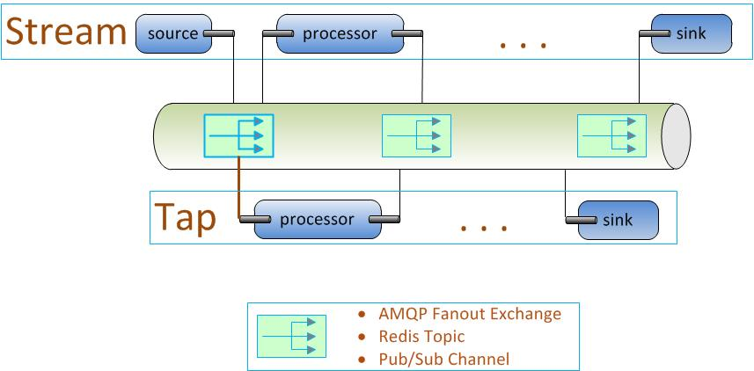
Spring XD - Taps
“Listen” to data from another stream
Other stream is unaffected by the tap and unaware of its presence
EAI ‘Wiretap’
Given the stream named ‘httpStream’
“tap:stream:httpStream > counter”

Slide 22
Spring XD – Processors for simple analytics
Simple Counter
Field Value Counter
Count occurrences of named fields
Aggregate Counter
Pre-aggregate counts in time buckets
Gauge
Last value
Rich Gauge
Last value, running average, min/max
Abstract API
Implementations for
Memory
Redis
Looking at
Pattern
JPMML

Slide 23
Spring XD Demo
Taps and Analytics
Notes:
Tap of twitter using field-value counters

Slide 24
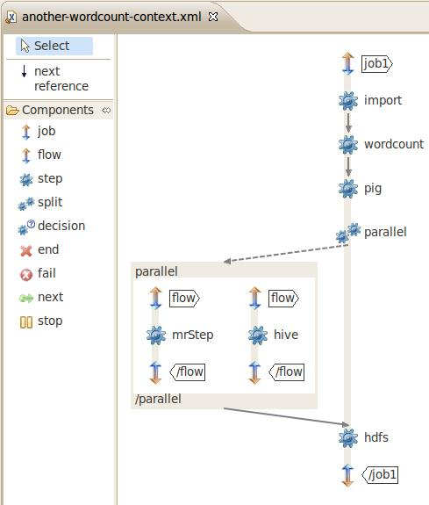
Spring XD - Jobs
Jobs are a directed graph of steps
Steps
Copy or Process data
Files, Databases, MR, Pig, Hive, Cascading
Step executions are persisted
Checkpointing with restart
Rich error handling capabilities
Single node or distributed with data partitioning
Jobs can be Triggered from streams
Executing jobs generate a stream of event data

Slide 25
Spring XD Demo
Batch Jobs
Notes:
Word count

Slide 26
Learn More
Project: http://projects.spring.io/spring-xd/
Issues: https://jira.springsource.org/browse/XD
GitHub: https://github.com/spring-projects/spring-xd/
Wiki: https://github.com/spring-projects/spring-xd/wiki
Samples: https://github.com/spring-projects/spring-xd-samples
EC2 Support: https://github.com/spring-projects/spring-xd-ec2

